Slide 1













Logistic Regression
By Group 2

Slide 2
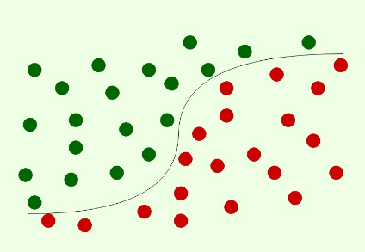
What is Logistic Regression?

Slide 3
Logistic regression is a classification algorithm. It is used to predict a binary outcome based on a set of independent variables. A binary outcome is one where there are only two possible scenarios—either the event happens (1) or it does not happen (0). Independent variables are those variables or factors which may influence the outcome (or dependent variable).
01
02
It is used to describe data and to explain the relationship between one dependent binary variable and one or more nominal, ordinal, interval or ratio-level independent variables.

Slide 4
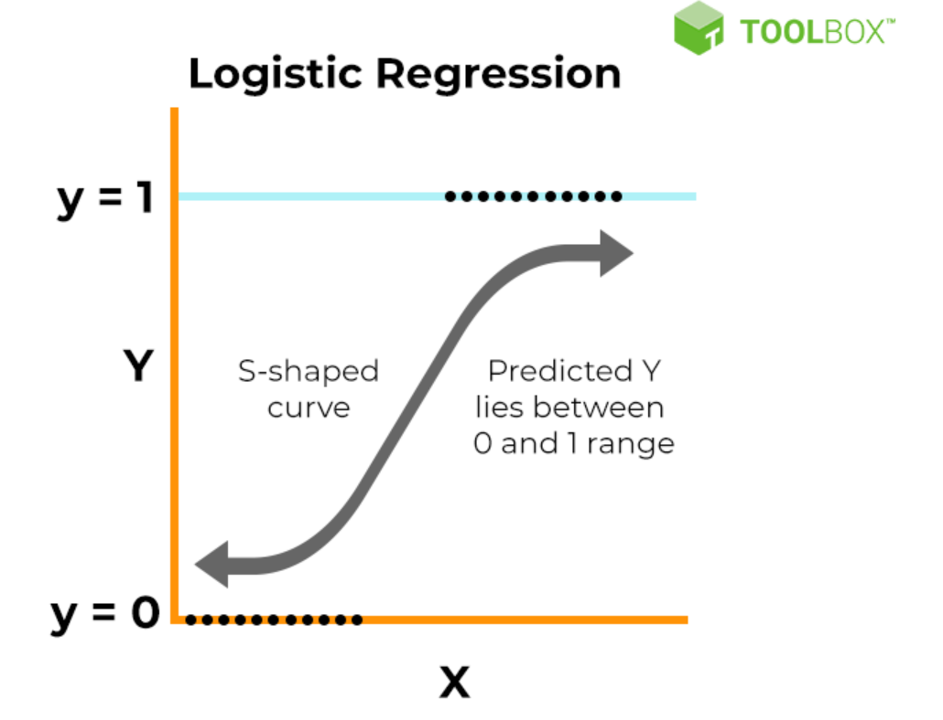
As the input (x) becomes very negative, the output of the logistic function approaches 0.
As the input becomes very positive, the output approaches 1.
In the middle range of inputs, the curve transitions smoothly from 0 to 1.

Slide 5

What are the advantages and disadvantages of using Logistic Regression?

Slide 6
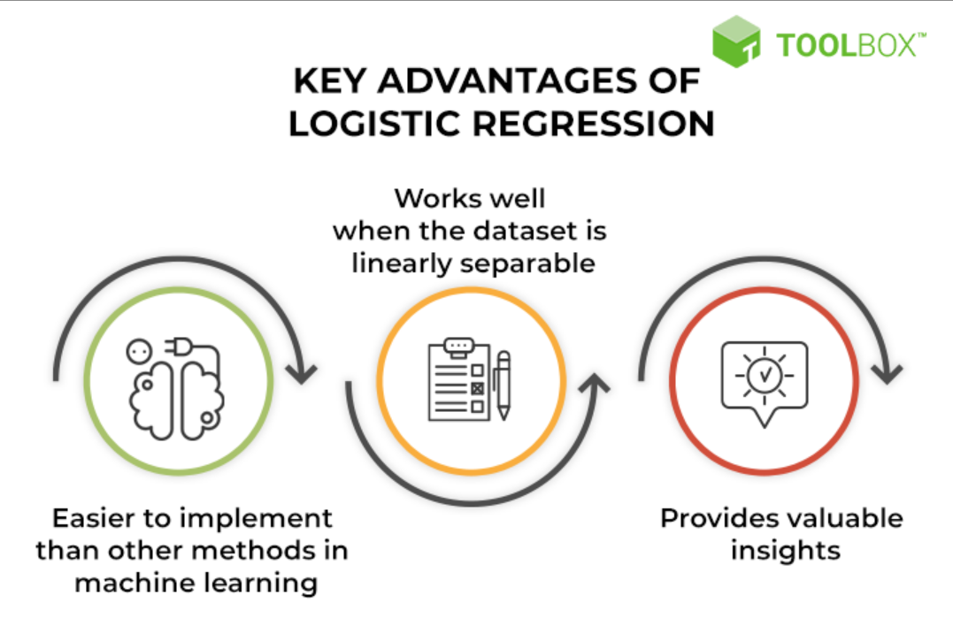
Notes:
wehhh

Slide 7

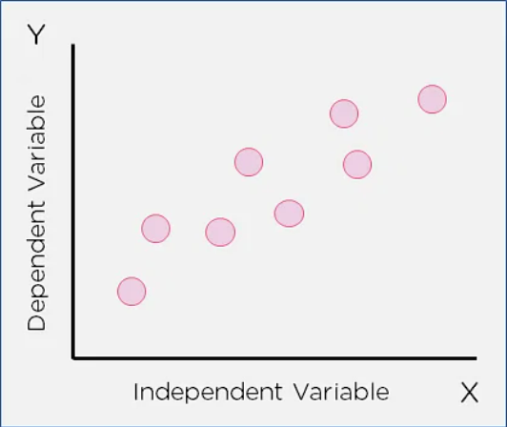
Disadvantages of using Logistic Regression?
Logistic regression fails to predict a continuous outcome.
Logistic regression assumes linearity between the predicted (dependent) variable and the predictor (independent) variables.
Logistic regression may not be accurate if the sample size is too small.

Slide 8
Types of Logistic Regression
01
Binary Regression
02
Multinomial Logistic Regression
03
Ordinal logistic regression

Slide 9
Binary Regression
Binary regression deals with two possible values, essentially: yes or no.
Example: Whether or not to lend to a bank customer (outcomes are yes or no).

Slide 10
Multinomial Logistic Regression
Multinomial logistic regression deals with three or more values. Multinomial logistic regression is a model where there are multiple classes that an item can be classified as. There is a set of three or more predefined classes set up prior to running the model.
Example: Predicting whether a student will go to college, trade school or into the workforce.

Slide 11
Ordinal logistic regression
Ordinal logistic regression deals with three or more classes in a predetermined order. Ordinal logistic regression is also a model where there are multiple classes that an item can be classified as; however, in this case an ordering of classes is required. Classes do not need to be proportionate. The distance between each class can vary.
Example: Ranking restaurants on a scale of 0 to 5 stars.

Slide 12


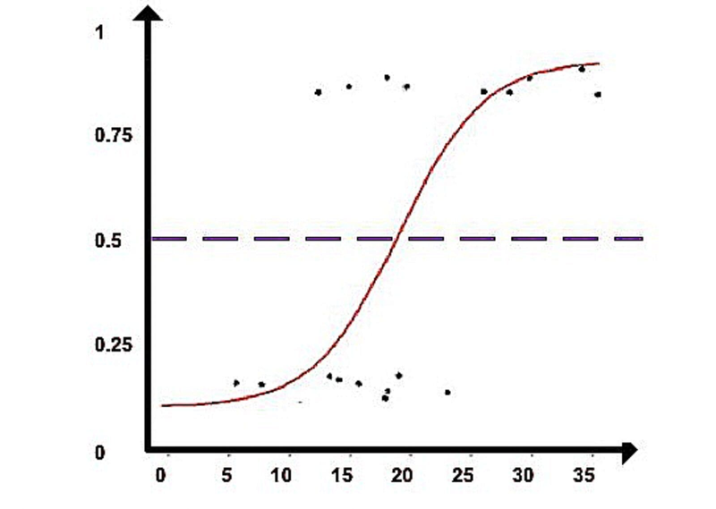

How does
Logistic Regression work?

Slide 13
Machine learning generally involves predicting a quantitative outcome or a qualitative class. The former is commonly referred to as a regression problem. In the scenario of linear regression, the input is a continuous variable, and the prediction is a numerical value. When predicting a qualitative outcome (class), the task is considered a classification problem. Examples of classification problems include predicting what products a user will buy or if a target user will click on an online advertisement.
In practice, the logistic regression algorithm analyzes relationships between variables. It assigns probabilities to discrete outcomes using the Sigmoid function, which converts numerical results into an expression of probability between 0 and 1.0. Probability is either 0 or 1, depending on whether the event happens or not. For binary predictions, you can divide the population into two groups with a cut-off of 0.5. Everything above 0.5 is considered to belong to group A, and everything below is considered to belong to group B.

Slide 14
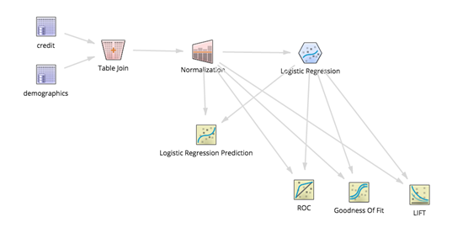
Use cases of Logistic Regression
1. Fraud detection
Logistic regression models can help teams identify data anomalies, which are predictive of fraud.

Slide 15
Use cases of Logistic Regression
2. Disease prediction
In medicine, this analytics approach can be used to predict the likelihood of disease or illness for a given population.

Slide 16
Use cases of Logistic Regression
3. Churn prediction
Specific behaviors may be indicative of churn in different functions of an organization. For example, human resources and management teams may want to know if there are high performers within the company who are at risk of leaving the organization;

Slide 17
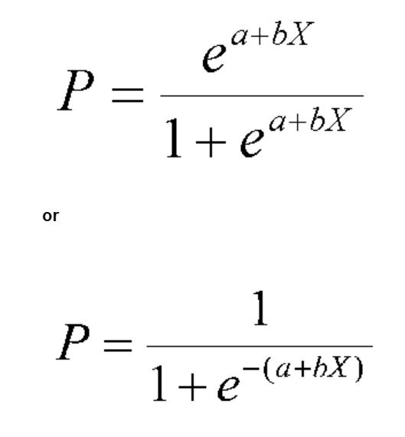
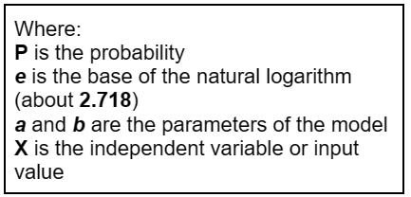
Logistic Regression Equation

Slide 18
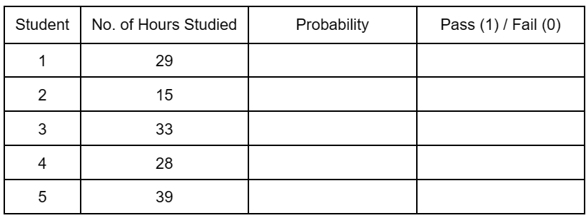
Problem
01
Calculate the probability of Pass (1) / Fail (0) in an exam of 5 students with their corresponding number of hours studied. Determine the output value (0 if P < 0.50 and 1 if P > 0.50) using parameters a = -64 and b = 2.

Slide 19
Solution
Student 1
1
1
P =
P =
1 + 2.718⁶
1 + e ⁻ ⁽ᵃ ⁺ ᵇˣ⁾
1
e = 2.718
a = -64
b = 2
X = 29
P =
1 + 403.18
1
1
P =
P =
1 + 2.718 ⁻⁽⁻⁶⁴ ⁺ ²*²⁹⁾
404.18
1
P =
P = 0.0024 or
P = 0.00
1 + 2.718 ⁻⁽⁻⁶⁴ ⁺ ⁵⁸⁾
1
P =
1 + 2.718 ⁻⁽⁻⁶⁾
Therefore, output value is 0 or Fail.

Slide 20
Student | No. of Hours Studied | Probability | Pass (1) / Fail (0)
1 | 29 | 0.00 | 0
2 | 15
3 | 33
4 | 28
5 | 39

Slide 21
Solution
Student 2
1
1
P =
P =
1 + e ⁻ ⁽ᵃ ⁺ ᵇˣ⁾
1 + 2.718³⁴
1
e = 2.718
a = -64
b = 2
X = 15
P =
1 + 581,408,510,000,000
1
1
P =
P =
581,408,510,000,001
1 + 2.718 ⁻⁽⁻⁶⁴ ⁺ ²*¹⁵⁾
1
P = 0.0000000000000017199610648 or
P = 0.00
P =
1 + 2.718 ⁻⁽⁻⁶⁴ ⁺ ³⁰⁾
1
P =
Therefore, output value is 0 or Fail.
1 + 2.718 ⁻⁽⁻³⁴⁾

Slide 22
Student | No. of Hours Studied | Probability | Pass (1) / Fail (0)
1 | 29 | 0.00 | 0
2 | 15 | 0.00 | 0
3 | 33
4 | 28
5 | 39

Slide 23
Solution
Student 3
1
1
P =
P =
1 + e ⁻ ⁽ᵃ ⁺ ᵇˣ⁾
1 + 0.14
1
e = 2.718
a = -64
b = 2
X = 33
P =
1.14
1
P = 0.88
P =
1 + 2.718 ⁻⁽⁻⁶⁴ ⁺ ²*³³⁾
0 if P < 0.50 and 1 if P > 0.50
1
P =
1 + 2.718 ⁻⁽⁻⁶⁴ ⁺ ⁶⁶⁾
P = 0.88 > 0.50
1
Therefore, output value is 1 or Pass.
P =
1 + 2.718 ⁻⁽²⁾

Slide 24
Student | No. of Hours Studied | Probability | Pass (1) / Fail (0)
1 | 29 | 0.00 | 0
2 | 15 | 0.00 | 0
3 | 33 | 0.88 | 1
4 | 28
5 | 39

Slide 25
Solution
Student 4
1
1
P =
P =
1 + e ⁻ ⁽ᵃ ⁺ ᵇˣ⁾
1 + 2.718⁸
1
P =
e = 2.718
a = -64
b = 2
X = 28
1 + 2978.49
1
1
P =
P =
2979.49
1 + 2.718 ⁻⁽⁻⁶⁴ ⁺ ²*²⁸⁾
1
P = 0.0003356279094 or
P = 0.00
P =
1 + 2.718 ⁻⁽⁻⁶⁴ ⁺ ⁵⁶⁾
1
P =
Therefore, output value is 0 or Fail.
1 + 2.718 ⁻⁽⁻⁸⁾

Slide 26
Student | No. of Hours Studied | Probability | Pass (1) / Fail (0)
1 | 29 | 0.00 | 0
2 | 15 | 0.00 | 0
3 | 33 | 0.88 | 1
4 | 28 | 0.00 | 0
5 | 39

Slide 27
Solution
Student 5
1
1
P =
P =
1 + e ⁻ ⁽ᵃ ⁺ ᵇˣ⁾
1 + 0.00000832736626
1
e = 2.718
a = -64
b = 2
X = 39
P =
1 .00000832736626
1
P =
P = 0.9999916727419 or
P = 1
1 + 2.718 ⁻⁽⁻⁶⁴ ⁺ ²*³⁹⁾
1
P =
1 + 2.718 ⁻⁽⁻⁶⁴ ⁺ ⁷⁸⁾
Therefore, output value is 1 or Pass.
1
P =
1 + 2.718 ⁻⁽¹⁴⁾

Slide 28
Student | No. of Hours Studied | Probability | Pass (1) / Fail (0)
1 | 29 | 0.00 | 0
2 | 15 | 0.00 | 0
3 | 33 | 0.88 | 1
4 | 28 | 0.00 | 0
5 | 39 | 1 | 1

Slide 29
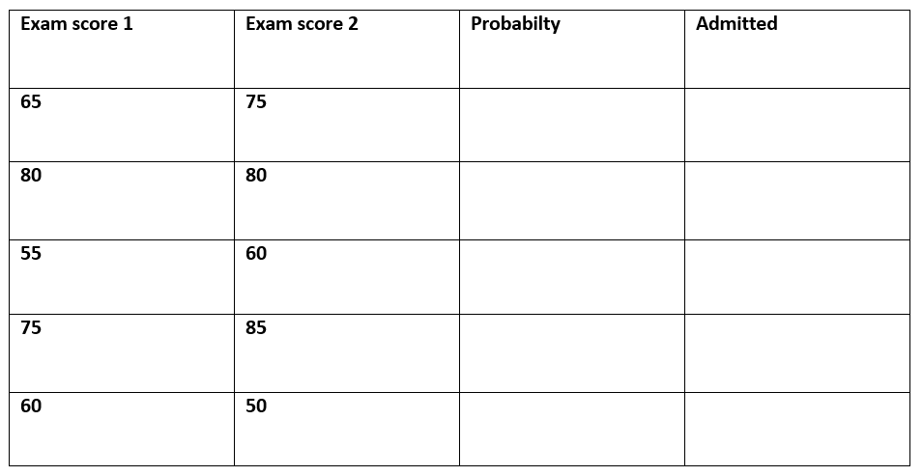
Problem
02
Suppose you are given a dataset containing information about students— their exam scores. Predict the probability of whether they were admitted to a university (1 for admitted, 0 for not admitted) based on exam scores.

Slide 30
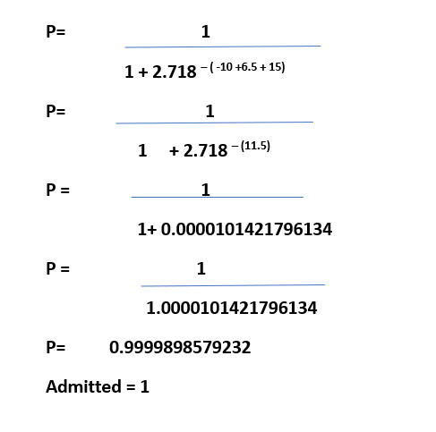
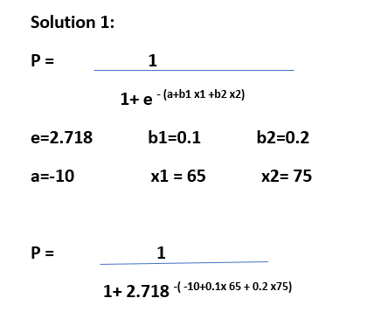
Solution

Slide 31
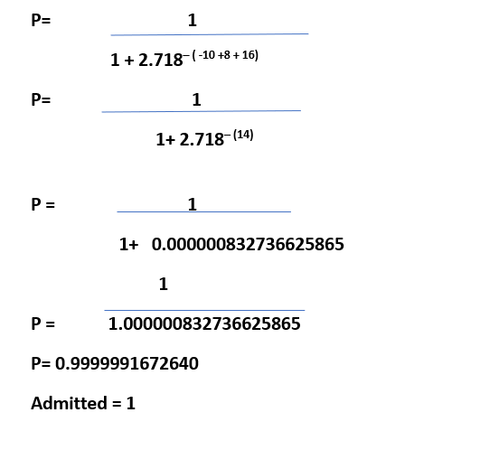
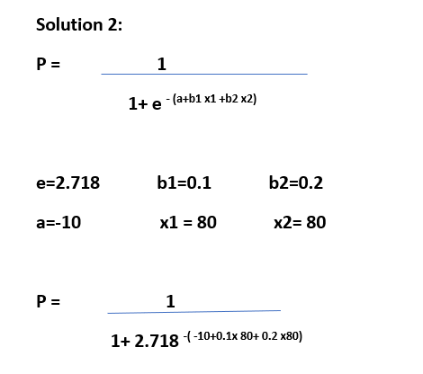
Solution

Slide 32
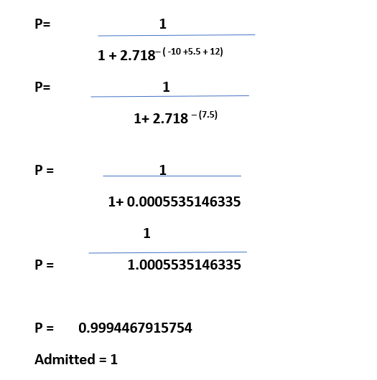
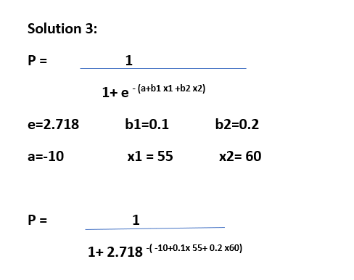
Solution

Slide 33
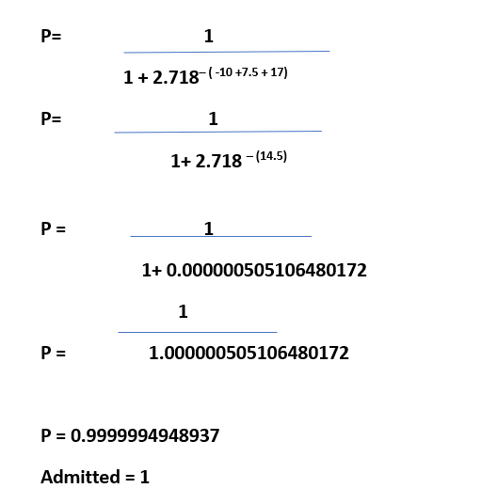
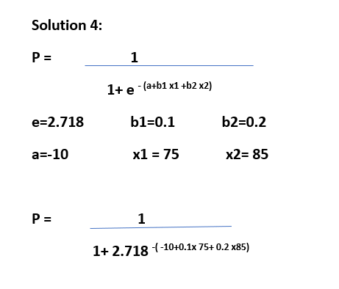
Solution

Slide 34
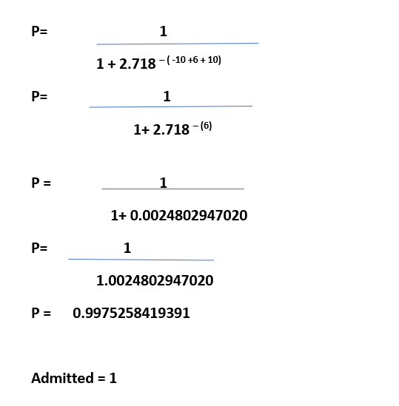
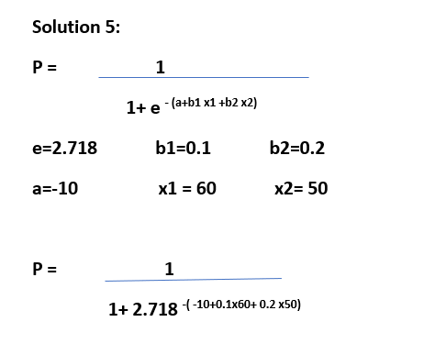
Solution

Slide 35
Solution
Exam score 1 | Exam score 2 | Probabilty | Admitted
65 | 75 | 0.9999898579232 | 1
80 | 80 | 0.9999991672640 | 1
55 | 60 | 0.9994467915754 | 1
75 | 85 | 0.9999994948937 | 1
60 | 50 | 0.9975258419391 | 1

Slide 36
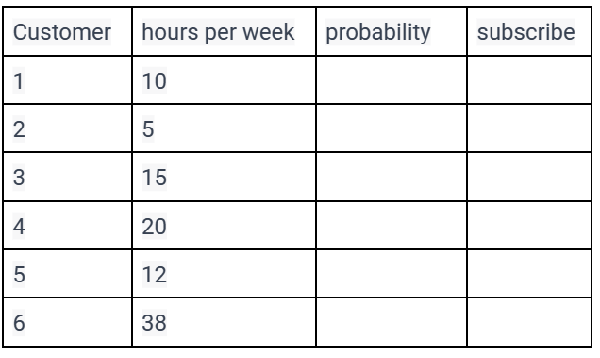
Problem
03
Suppose you work for a streaming service, and you want to predict whether a customer will subscribe to a premium plan based on the number of hours they spend using the service per week. Determine the output value(0 P<0.50 and 1 if P>0.50) using parameters a= -3 and b=0.5.

Slide 37
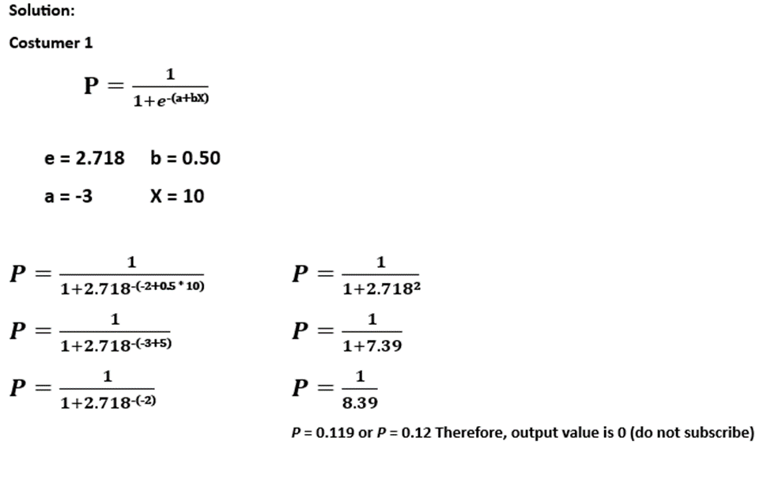
Solution

Slide 38
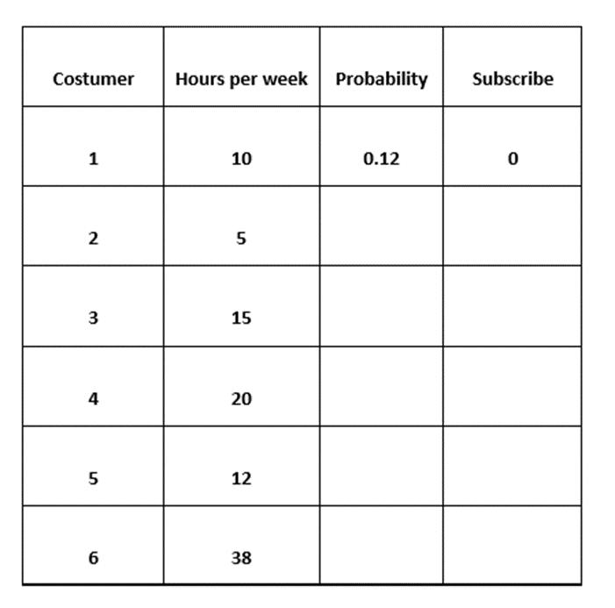

Slide 39
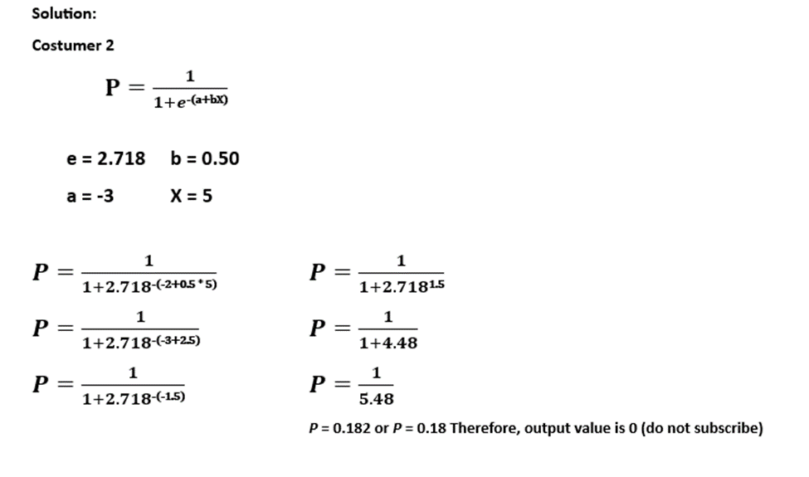
Solution

Slide 40
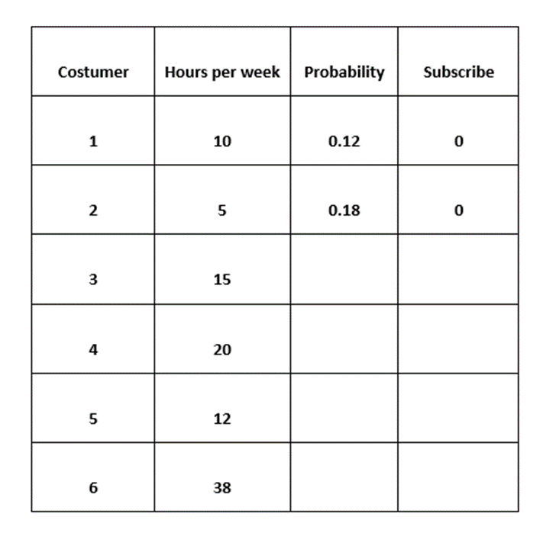

Slide 41
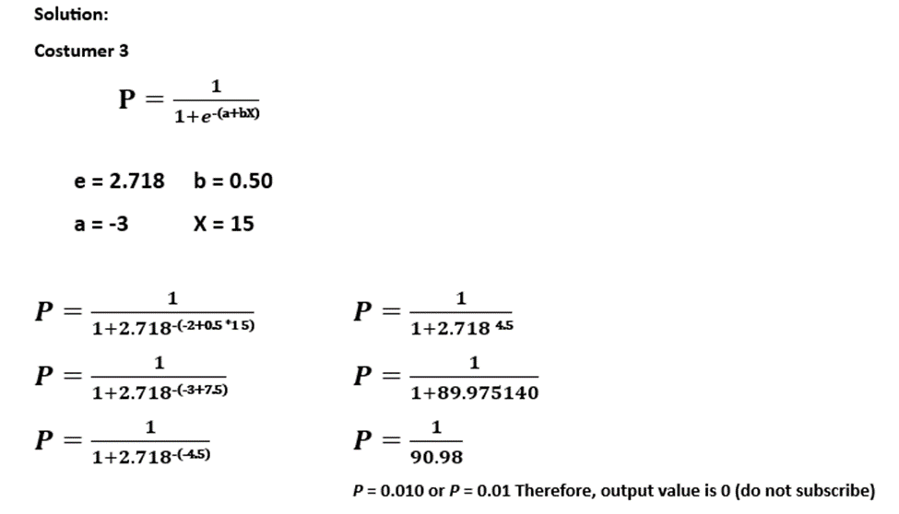
Solution

Slide 42
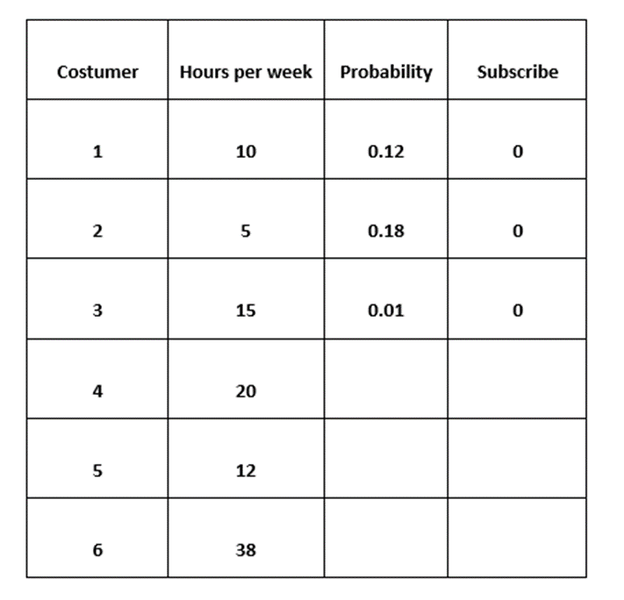

Slide 43
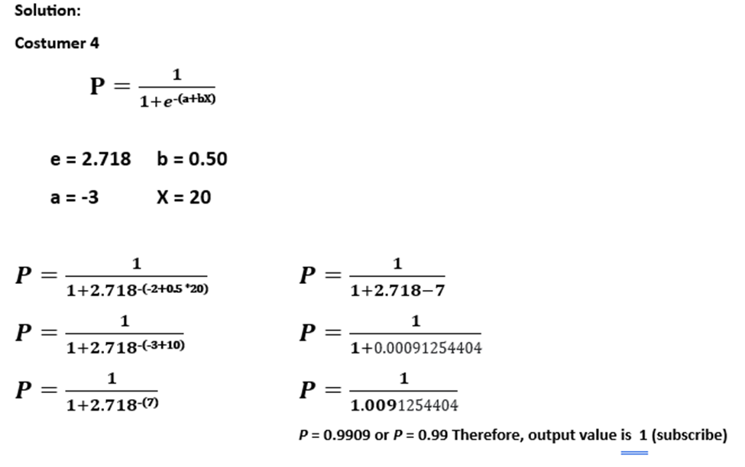
Solution

Slide 44
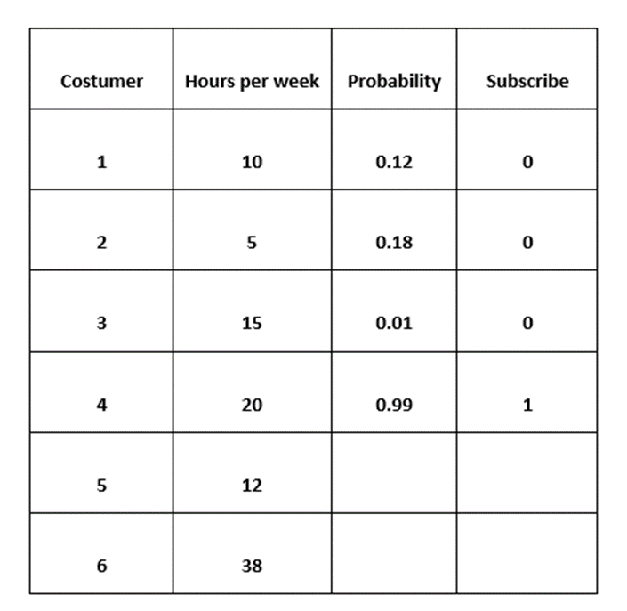

Slide 45
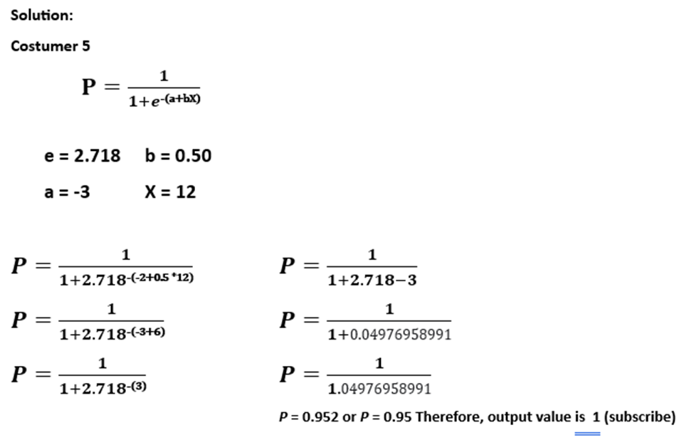
Solution

Slide 46
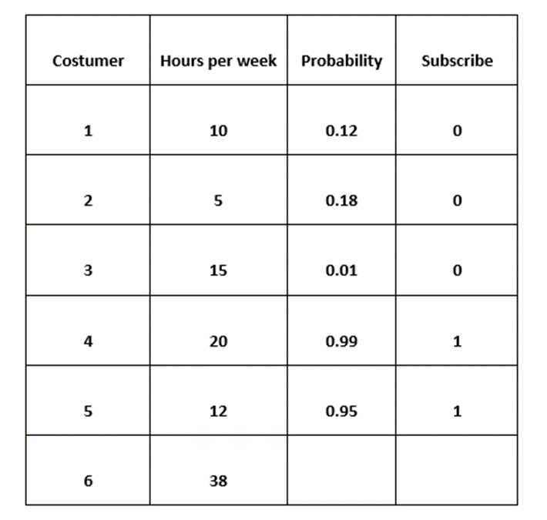

Slide 47
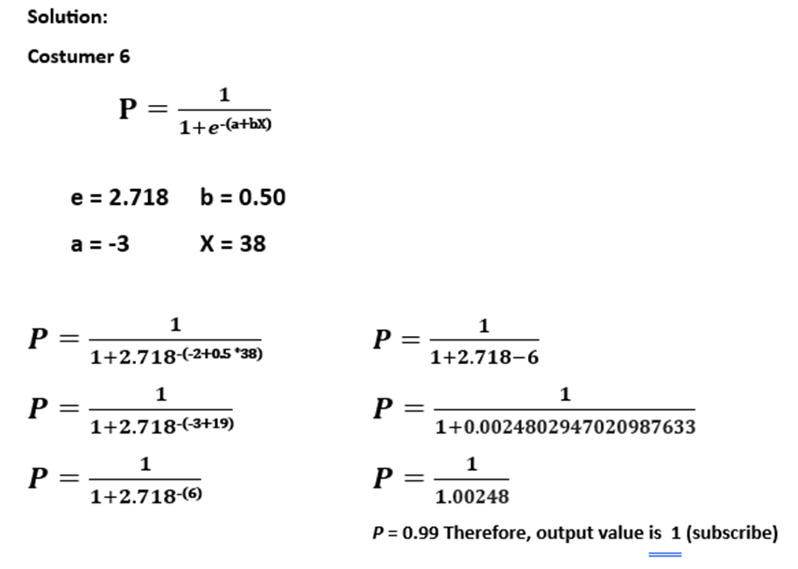
Solution

Slide 48
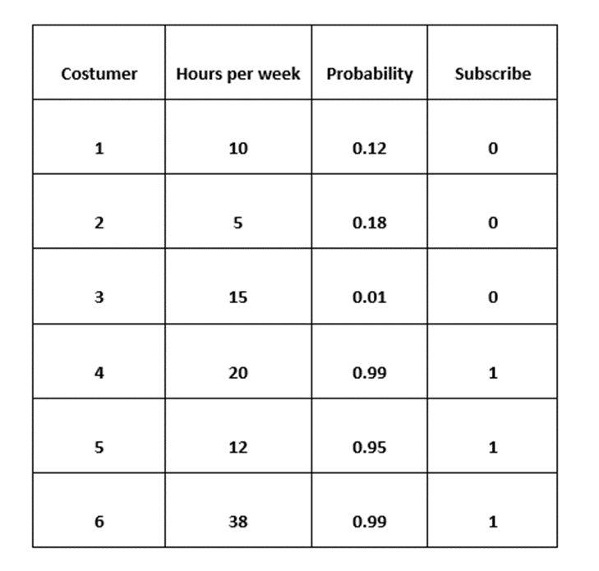

Slide 49
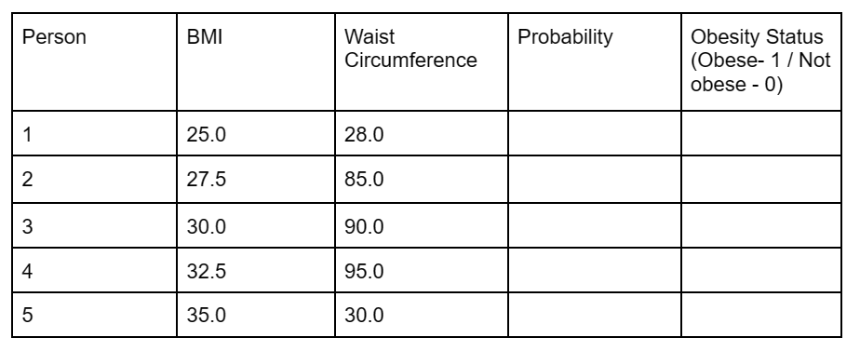
Problem
04
Predict whether a person is obese (1) or not obese (0) based on two features: "BMI (Body Mass Index)" and "Waist Circumference". Determine the output value (0 if P < 0.50 and 1 if P > 0.50) using parameters a = -6.482 b1 = 0.215 and b2 = 0.053.

Slide 50
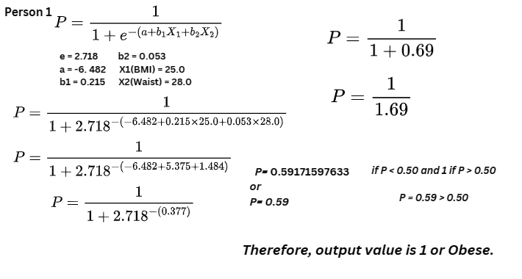
Solution

Slide 51
Person | BMI | Waist Circumference | Probability | Obesity Status (Obese- 1 / Not obese - 0)
1 | 25.0 | 28.0 | 0.59 | 1
2 | 27.5 | 85.0
3 | 30.0 | 90.0
4 | 32.5 | 95.0
5 | 35.0 | 100.0

Slide 52
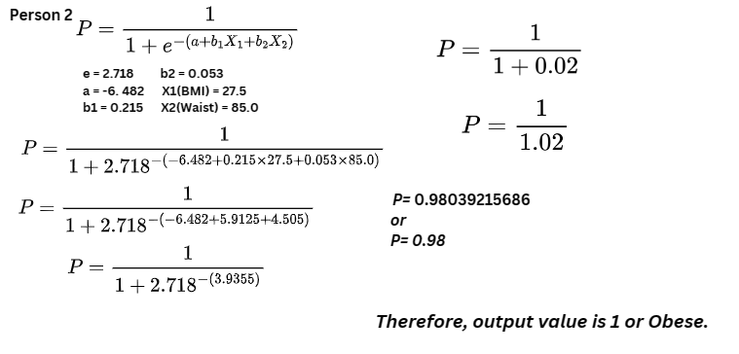
Solution

Slide 53
Person | BMI | Waist Circumference | Probability | Obesity Status (Obese- 1 / Not obese - 0)
1 | 25.0 | 28.0 | 0.59 | 1
2 | 27.5 | 85.0 | 0.98 | 1
3 | 30.0 | 90.0
4 | 32.5 | 95.0
5 | 35.0 | 100.0

Slide 54
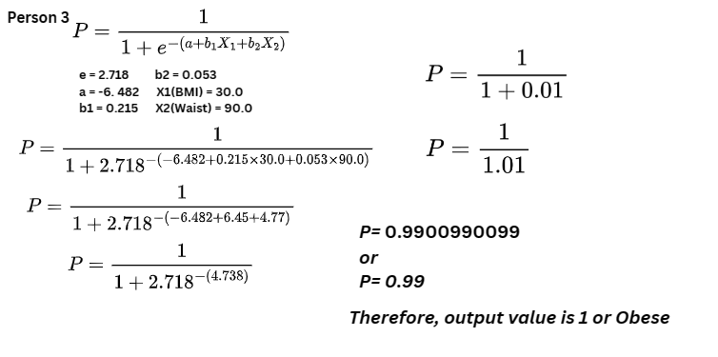
Solution

Slide 55
Person | BMI | Waist Circumference | Probability | Obesity Status (Obese- 1 / Not obese - 0)
1 | 25.0 | 28.0 | 0.59 | 1
2 | 27.5 | 85.0 | 0.98 | 1
3 | 30.0 | 90.0 | 0.99 | 1
4 | 32.5 | 95.0
5 | 35.0 | 100.0

Slide 56
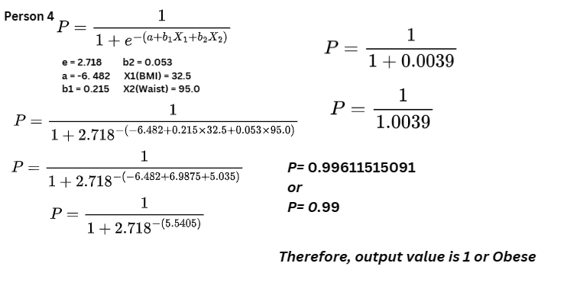
Solution

Slide 57
Person | BMI | Waist Circumference | Probability | Obesity Status (Obese- 1 / Not obese - 0)
1 | 25.0 | 28.0 | 0.59 | 1
2 | 27.5 | 85.0 | 0.98 | 1
3 | 30.0 | 90.0 | 0.99 | 1
4 | 32.5 | 95.0 | 0.99 | 1
5 | 35.0 | 100.0

Slide 58
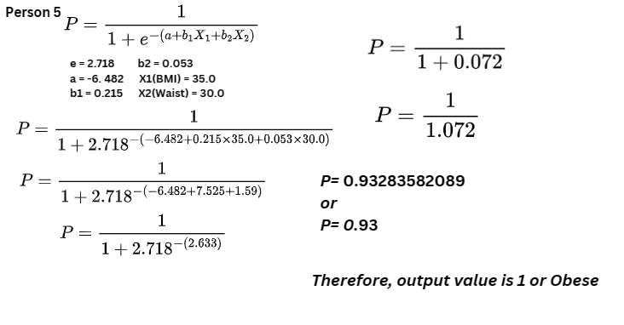
Solution

Slide 59
Person | BMI | Waist Circumference | Probability | Obesity Status (Obese- 1 / Not obese - 0)
1 | 25.0 | 28.0 | 0.59 | 1
2 | 27.5 | 85.0 | 0.98 | 1
3 | 30.0 | 90.0 | 0.99 | 1
4 | 32.5 | 95.0 | 0.99 | 1
5 | 35.0 | 100.0 | 0.93 | 1

